Slide 1
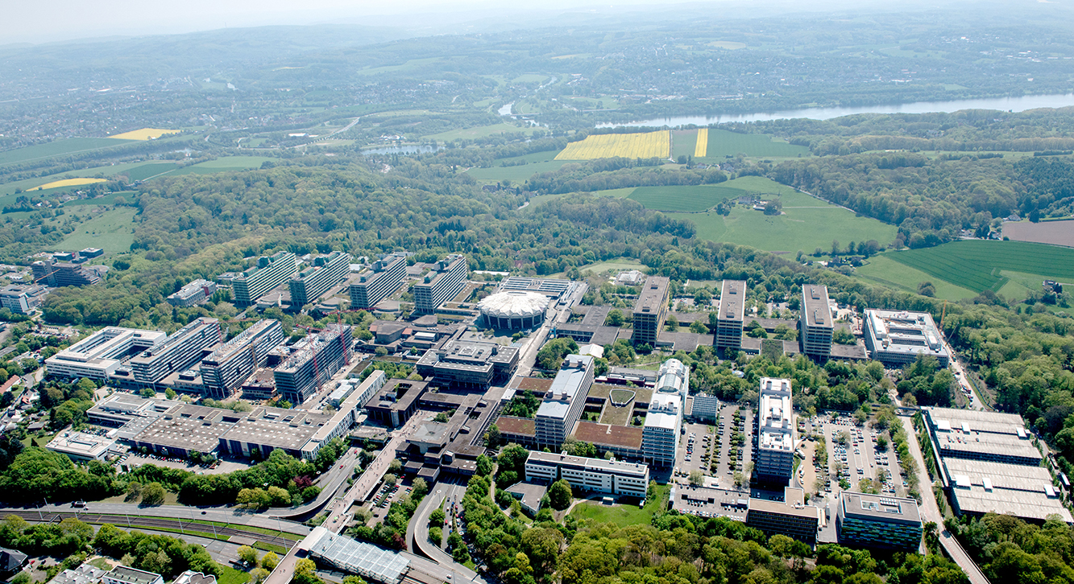


Perceptron Algorithm
Parallel Computing SS18
Lennard Flegel, Alexander Mardorf, Bajram Ibishi, Franziska Thiemann

Slide 2
Outline
The Perceptron learning Algorithm
  What it does
  How it does that
  Why it works
Software architecture
Going Parallel
  OpenMP in Java and why it sucked
  Our workaround
Benchmarking
  In a perfect world
  In a world without race conditions
  In our world
Conclusion
Sources
The Algorithm – Architecture – Going parallel – Benchmarking - Conclusion

Slide 3
Perceptron Algorithm
Vorstellung Algorithmus grundsätzlich; Pseudocode
Erklärung mit Hunden und Katzen von Wikipedia ?
The Algorithm – Architecture – Going parallel – Benchmarking - Conclusion

Slide 4
Perceptron Algorithm
Vorstellung Mathematisch

Slide 5
Perceptron Algorithm
Unserer Anpassung des Algorithmus
The Algorithm – Architecture – Going parallel – Benchmarking - Conclusion
Notes:
Hier Idee zur Parallelisieren oder weiter unter ?

Slide 6
Class diagram
The Algorithm – Architecture – Going parallel – Benchmarking - Conclusion
Notes:
Einzelne Klassen kurz vorstellen, Logik explizit vorstellen

Slide 7
Perceptron Algorithm
Unserer Anpassung des Algorithmus
The Algorithm – Architecture – Going parallel – Benchmarking - Conclusion
Notes:
Hier Idee zur Parallelisieren oder weiter unter ?

Slide 8
Going Parallel
dsdsdsdsd
The Algorithm – Architecture – Going parallel – Benchmarking - Conclusion
Notes:
Idee der Parallelisierung vorstellen

Slide 9
Parallele Teil des Programms
dsdsdsdsd
The Algorithm – Architecture – Going parallel – Benchmarking - Conclusion
Notes:
Idee der Parallelisierung vorstellen

Slide 10
Benchmarks
dsdsdsdsd
The Algorithm – Architecture – Going parallel – Benchmarking - Conclusion
Notes:
Idee der Parallelisierung vorstellen

Slide 11
Parallel Problems
dsdsdsdsd
The Algorithm – Architecture – Going parallel – Benchmarking - Conclusion
Notes:
Idee der Parallelisierung vorstellen

Slide 12
Parallel Problems
dsdsdsdsd
The Algorithm – Architecture – Going parallel – Benchmarking - Conclusion
Notes:
Idee der Parallelisierung vorstellen

Slide 13
Sources
dsdsdsdsd
The Algorithm – Architecture – Going parallel – Benchmarking - Conclusion
Notes:
Idee der Parallelisierung vorstellen

